Slide 1
Lesson 2 – Built-In Classes

Slide 2
Lesson goals
Built-In Classes
String
StringBuilder vs. StringBuffer
Util Classes
Wrapper Classes
Hierarchy
Autoboxing && Unboxing
System Info

Slide 3
Classes of package “java.lang”
Object
String, StringBuilder, StringBuffer
Wrapper Clases
Math
System
…

Slide 4
java.lang.Object
In Java, "almost" all data are objects and inherit Object.

Slide 5
java.lang.Object
In Java, "almost" all data are objects and inherit Object.
boolean equals(Object);
int hashCode();
String toString();
…

Slide 6
java.lang.String
Data type String is used for storing sequence of Unicode characters.
String empty = "";
String emptyUsingConstructor = new String ();
String flash = new String ("Flash") ;
String batman = "Batman" ;
String concatMessage = "NaNaNaNaNa ".concat(batman);
String plusMessage = "NaNaNaNaNa " + batman;

Slide 7
Immutability of String
String upperCase = "UPPER_CASE";

Slide 8
Immutability of String
String upperCase = "UPPER_CASE"; System.out.println(upperCase.toLowerCase()); // ???

Slide 9
Immutability of String
String upperCase = "UPPER_CASE"; System.out.println(upperCase.toLowerCase()); // upper_case
System.out.println(upperCase); // ???

Slide 10
Immutability of String
String upperCase = "UPPER_CASE"; System.out.println(upperCase.toLowerCase()); // upper_case
System.out.println(upperCase); // UPPER_CASE

Slide 11
Useful methods of String class
int length(); boolean isEmpty();
boolean isBlank(); boolean equals(Object anObject); boolean startsWith(String prefix); int indexOf(int ch);
String repeat(int count); String substring(int beginIndex, int endIndex); String concat(String str); boolean contains(CharSequence s); String replace(char oldChar, char newChar); String strip(); String[] split(String regex);
static String join(CharSequence delimiter, Iterable<? extends CharSequence> elements)
…

Slide 12
StringBuilder vs StringBuffer
public StringBuilder append(Object obj); public StringBuilder appendCodePoint(int codePoint); public StringBuilder delete(int start, int end); public StringBuilder replace(int start, int end, String str); public StringBuilder insert(int index, char[] str, int offset); public int indexOf(String str); public int lastIndexOf(String str); public StringBuilder reverse(); public String toString();

Slide 13
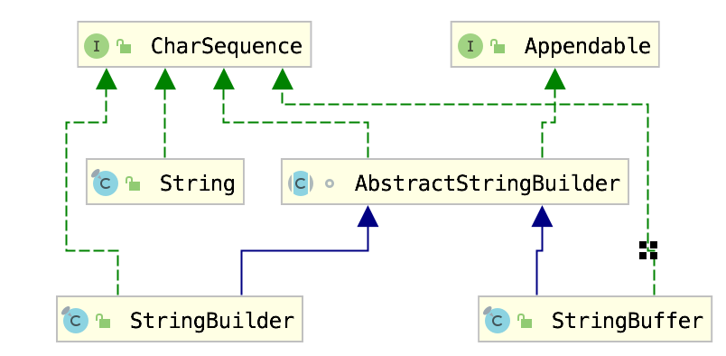
String vs StringBuilder vs StringBuffer Hierarchy

Slide 14
Comparison Table
 | String | StringBuilder | StringBuffer
Storage | String pool | Heap | Heap
Mutability | immutable | mutable | mutable
Specific | Has overloaded operator + | No overloaded operators | No overloaded operators
Purpose | Good for temporary literals and constants | Good frequently changed strings | Good frequently changed strings
Thread safety | Yes | No | Yes
Performance | Fast for literals | Fast | Slow

Slide 15
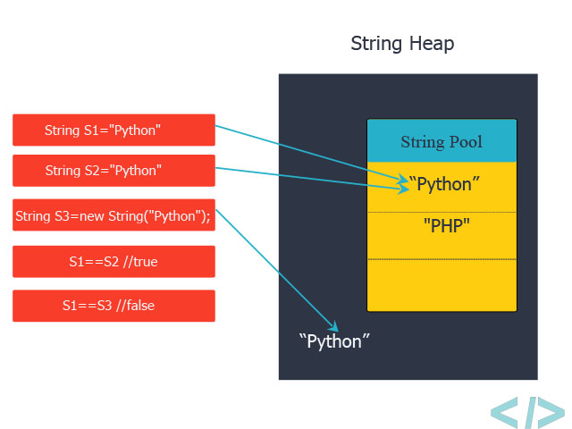
String Pool

Slide 16
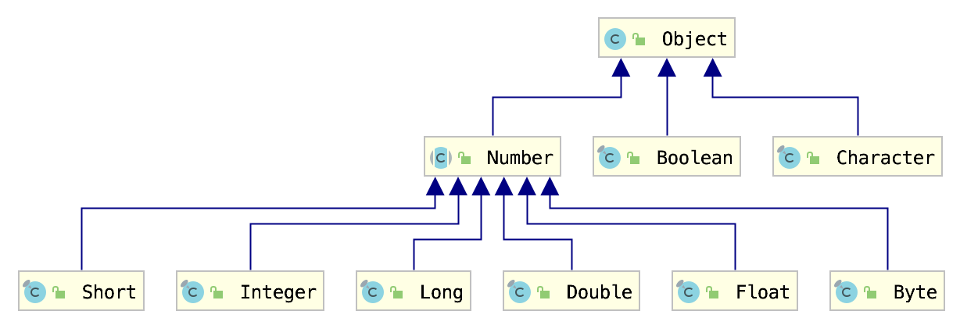
Wrapper Classes

Slide 17
Useful methods and fields
Wrapping methods:
Integer::valueOf(int);
Double::valueOf(double);

Slide 18
Useful methods and fields
Wrapping methods:
Integer::valueOf(int);
Integer::valueOf(String);
Double::valueOf(double);
Minimum or Maximum values of primitive types:
Byte.MIN_VALUE;
Float.MAX_VALUE;

Slide 19
Useful methods
Conversion to another type:
Number::byteValue
Number::shortValue
Number::intValue
Number::longValue
Number::floatValue
Number::doubleValue

Slide 20
Useful methods
Conversion to another type:
Number::byteValue
Number::shortValue
Number::intValue
Number::longValue
Number::floatValue
Number::doubleValue
Conversion to another number system:
Integer.toBinaryString(i);
Integer.toOctalString(i);
Float.toHexString(f);

Slide 21
Wrapper Classes
• Overloaded operations
• Pass by value
public static void sum(Integer i) { i = i + new Integer(2); } public static void main(String[] args) { Integer a = 10; sum(a); int b = 10; sum(b); System.out.println("a=" + a); System.out.println("b=" + b); }

Slide 22
Autoboxing && Unboxing
Integer autoboxing = 47; // -> Integer autoboxing = Integer.valueOf(47);
int unboxing = Integer.valueOf(47); // -> int unboxing = 47;

Slide 23
Performance Problem Example

Slide 24
Performance Problem Example
long startTime = System.currentTimeMillis(); Long sum = 0L; for (Long i = 0L; i < Integer.MAX_VALUE; i++) { sum += i; } System.out.println("total:" + sum); long executionTime = System.currentTimeMillis() - startTime; System.out.println("processing time: " + executionTime + " ms");

Slide 25
java.lang.Math
public static double sin(double a);
public static double cos(double a);
public static double exp(double a);
public static double sqrt(double a);
public static double pow(double a, double b);
public static int round(float a);
public static double random();
public static int abs(int a);
public static int max(int a, int b);
public static int min(int a, int b);

Slide 26
java.util.Arrays
public static void sort(int[] a);
public static int binarySearch(int[] a, int key);
public static boolean equals(int[] a, int[] a2);
public static boolean deepEquals(Object[] a1, Object[] a2);
public static void fill(int[] a, int val);
public static String toString(int[] a);

Slide 27
java.lang.System
System.out.printf("Hello World!");
System.out.println("Hello World!");
System.currentTimeMillis();
System.exit(1);
System.getProperty("path.separator");
System.gc();
System.arraycopy(
Object src, int srcPos, Object dest, int destPos, int length
);

Slide 28
java.util.Scanner
Scanner scanner = new Scanner(System.in); String string = scanner.next(); System.out.println(string); scanner.close();

Slide 29
java.util.Scanner
Scanner scanner = new Scanner(System.in); //may be String String string = scanner.next(); System.out.println(string); scanner.close();

Slide 30
java.util.Scanner
Scanner.next ();
Scanner.nextLine();
Scanner.nextInt();
Scanner.nextDouble();
Scanner.hasNextInt();

Slide 31
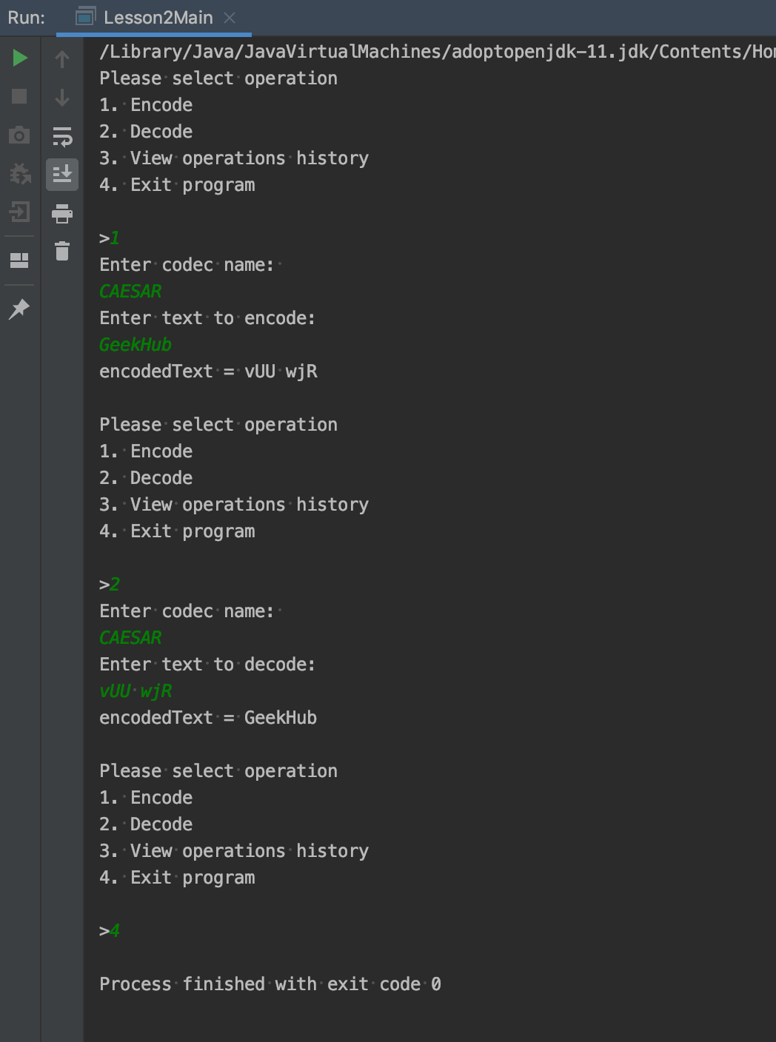
Homework
Use implementation of previous homework and create full “user friendly” console application that accept input from keyboard and prints result to console.

Slide 32
Homework
Requirements and features that should be implemented:
Display menu of available operations.
User input from keyboard.
Encode/Decode operations for codec that user wants to use.
Exit program by accepting command from keyboard by user
Application should work and accept user input until he want to exit from program.
List of all operations performed by user, use array for storing this information in format: “[operation index]. [operation name] - [user input]”.

Slide 33
Homework
Example of operations history output:
1. Encode – 1
2. Codec Name – CAESAR
3. Text To Encode – GeekHub
4. Decode – 2
5. Codec Name – CAESAR
6. Text To Decode – vUU vjR
7. History – 4
…
99. Decode – 2
100. Codec Name – MORSE
…

Slide 34
Links
The Number Classes
Autoboxing and Unboxing
Strings
Java User Input (Scanner)
Arrays
Wrappers Cache Details

Slide 35
Sites for practice
https://www.hackerrank.com/
https://www.codewars.com/
https://exercism.io/

Slide 36
Thanks!
Any Questions?
Or find us in Slack:
@Yaroslav Brahinets
@Vasya Rudas
@Oleksandr Kucher

